Slide 1
Leaving the Past Behind: Exploring the Adverse Childhood Experiences of Males Detained to a
Secure Specialist Deaf Inpatient Mental Health Service
Webb. E. L, Baker. K, Morris. D, Nawab. Z, Gencarelli. B, Worsfold. J, & Hamilton. A.

Slide 2
Childhood trauma has been linked to a range of negative outcomes, including mental health problems, substance abuse and criminal behaviour.
Deaf people are at increased risk of experiencing childhood trauma (Archer & Zoller, 2018; Kushalnagar et al., 2020), including abuse and neglect. Communication and social isolation make them more vulnerable.
Deaf people often face pervasive exposure to trauma, with research indicating exposure to an average of 6.2 different trauma types in an outpatient sample (Ohre et al., 2015).
Despite deaf people being over-represented in secure services, (Mitchell & Braham, 2011), we don’t know much about rates of adverse childhood experiences in this population.
The focus on abuse and neglect, without consideration of indirect household adversities (e.g., parental incarceration), may limit our understanding of the early trauma experiences of this population.
We investigated the prevalence of ACEs, and their associations with demographic and clinical factors, in a sample of deaf males detained to secure care.
Background

Slide 3
Methodology
Design - A retrospective analysis was conducted on existing clinical records held by a specialist deaf secure inpatient mental health service between June and November 2021.
Participants - A convenience sample of 26 male adults (Mean age=39.5 years) were included in analyses. All participants had been diagnosed as deaf in childhood and used a range of communication styles including British Sign Language (BSL), Sign Supported English and spoken English.
Measures - Adverse Childhood Experiences were assessed using the ACE-Q (Felitti et al., 1998) measuring both ‘child maltreatment’ ACEs (e.g., physical abuse and emotional neglect) and ‘household’ ACEs (e.g., parental mental illness and domestic violence).
Permissions - The study was approved by the organisation, as a part of a wider review of service structures.

Slide 4
Number of ACES
92.31% of participants had been exposed to at least one ACE (1+)
84.6% had experienced multiple ACES (2+)
73.1% of participants had experienced four or more ACEs (4+)
Types of ACES
88.5% experienced at least one type of household ACE
84.6% experienced at least one type of child maltreatment ACE
76.9% experienced both child maltreatment and household ACEs.
Results
On average, participants had been exposed to 6 types of ACEs
On average, participants had experienced 3 child maltreatment ACEs
On average, participants had experienced 2.5 household ACEs
Number of child maltreatment ACEs experienced was significantly higher in participants who had been removed from the home under a compulsory care order (U = 18.00, p = .023).

Slide 5
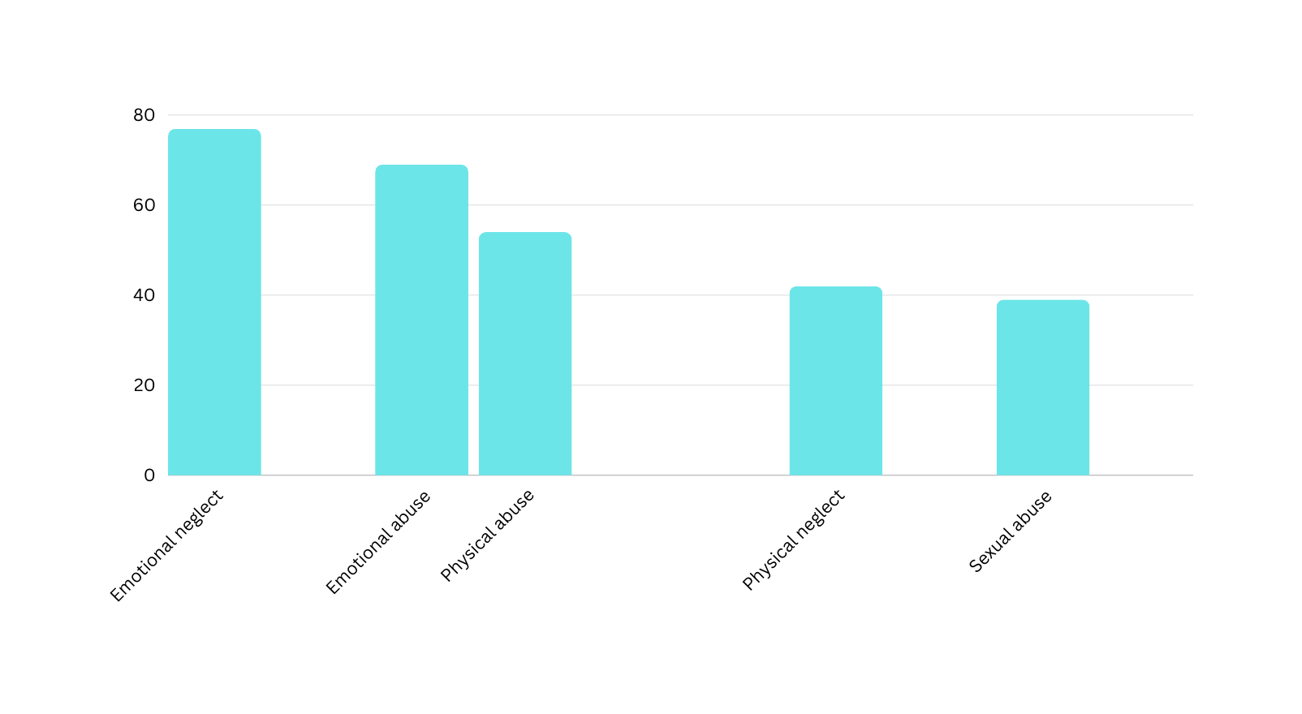
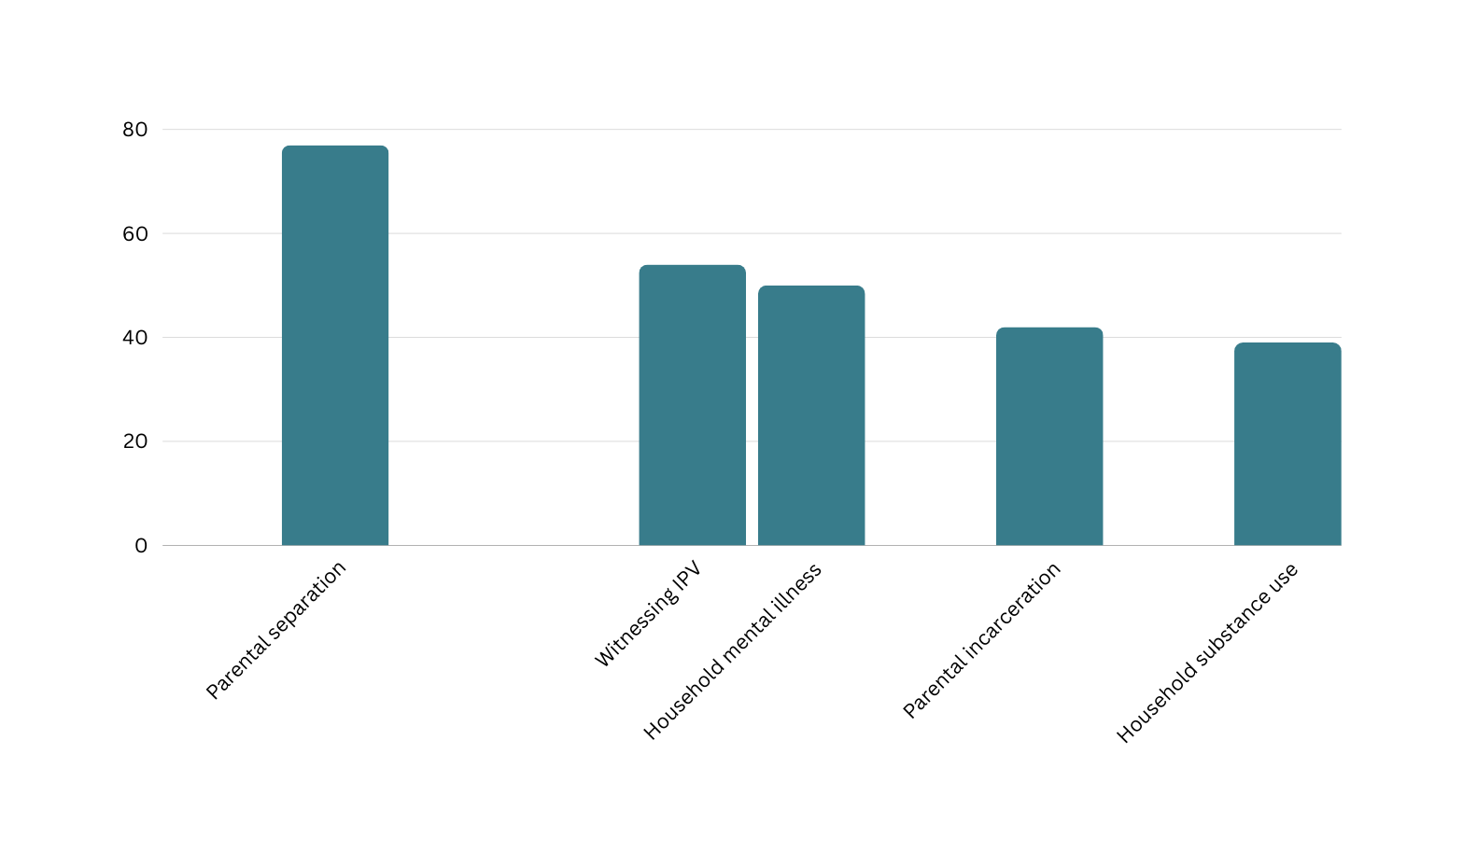
The most prevalent ACEs were emotional neglect and parental separation (76.9%) and emotional abuse (69.2%).
More than half (53.8%) had also experienced physical abuse and witnessed domestic violence within the household.
Whilst sexual abuse and household substance use were least commonly reported, more than a third of participants had been exposed to these ACEs
Results
‘Indirect’ household ACEs
‘Direct’ child maltreatment ACEs

Slide 6
Need for effective assessment of trauma in deaf service users
Exposure to ACEs was almost universal, with rates that exceeded those reported in general population, adult male prison and other forensic samples.
There is a clear need for assessment and treatment for early trauma experiences of deaf people accessing inpatient mental health services.
Currently, no specific guidelines for this exist. We anticipate that lack of shared communication and a detailed understanding of deaf child development will be important.
Awareness of a broad range of potentially traumatic experiences
Polyvictimisation was pervasive across the sample, with three-quarters of participants experiencing both maltreatment and household ACEs.
Considering the family and developmental context of direct ACEs is critical to ensuring a more comprehensive understanding of the trauma needs of deaf service users.
Deaf people also face additional potentially traumatic experiences not captured within the ACEs framework (e.g., information deprivation trauma). Further research exploring these additional traumas is warranted.
Conclusions and implications

Slide 7
Full paper:
Webb, E. L., Baker, K., Morris, D., Nawab, Z., Lupattelli Gencarelli, B., Worsfold, J., & Hamilton, A. (2023). Leaving the Past Behind: Exploring the Adverse Childhood Experiences of Males Detained to a Secure Specialist Deaf Inpatient Mental Health Service. Journal of Forensic Psychology Research and Practice.
https://doi.org/10.1080/24732850.2023.2249443

